Slide 1

Google Cloud Storage: A Deep Dive
Explore Google Cloud Storage (GCS). Discover its vital role in modern distributed systems. Learn how it compares to AWS and Azure.

Slide 2

What is Google Cloud Storage?
GCS is Google’s object storage solution. It is designed for unstructured data. GCS provides a flexible, scalable, and secure solution.
Scalability
Security
Handles vast amounts of data.
Keeps your files safe.
Durability
Cost-Efficient
Ensures data accessibility.
Optimizes expenses.

Slide 3
Storage Classes
GCS offers four main storage classes. Each is tailored for different use cases. Choosing the right class optimizes costs.
Standard
Nearline
Coldline
Archive
Frequent access, high-performance.
Accessed less than once a month.
Long-term storage, accessed yearly.
Rarely accessed, most affordable.

Slide 4




Global Accessibility & Durability
Google’s infrastructure ensures data redundancy. It reduces the risk of data loss. GCS guarantees 99.999999999% durability.
Global Reach
High Security
Compliance
Access your data from anywhere.
Data encrypted at rest and transit.
Meets ISO, SOC, HIPAA, GDPR standards.

Slide 5

Security & Compliance
Security is a top priority with GCS. Data is encrypted at rest and in transit. Control access using IAM policies.
1
Encryption
2
IAM Policies
Data encrypted at rest and in transit.
Control access with authorized users.
3
Compliance
Meets major compliance standards.

Slide 6

Lifecycle Management & Versioning
Optimize costs with automated lifecycle policies. Move data to lower-cost storage classes over time. Object versioning helps recover files.
1
Automated Policies
Move data to lower-cost classes.
2
Cost Optimization
Reduce storage expenses.
3
Object Versioning
Recover previous file versions.

Slide 7




Integration with Google Cloud
GCS integrates with BigQuery, AI/ML tools, and GKE. Store datasets and analyze them using BigQuery. No complex data transfers needed.
BigQuery
Data analytics integration.
AI/ML Tools
Machine learning models.
GKE
Containerized applications.

Slide 8




Real-World Use Cases
Businesses use GCS for backups and disaster recovery. It acts as the foundation for data lakes. Store and distribute media at scale.
Backup & Recovery
1
Big Data Analytics
2
4
Application Data
3
Content Delivery

Slide 9
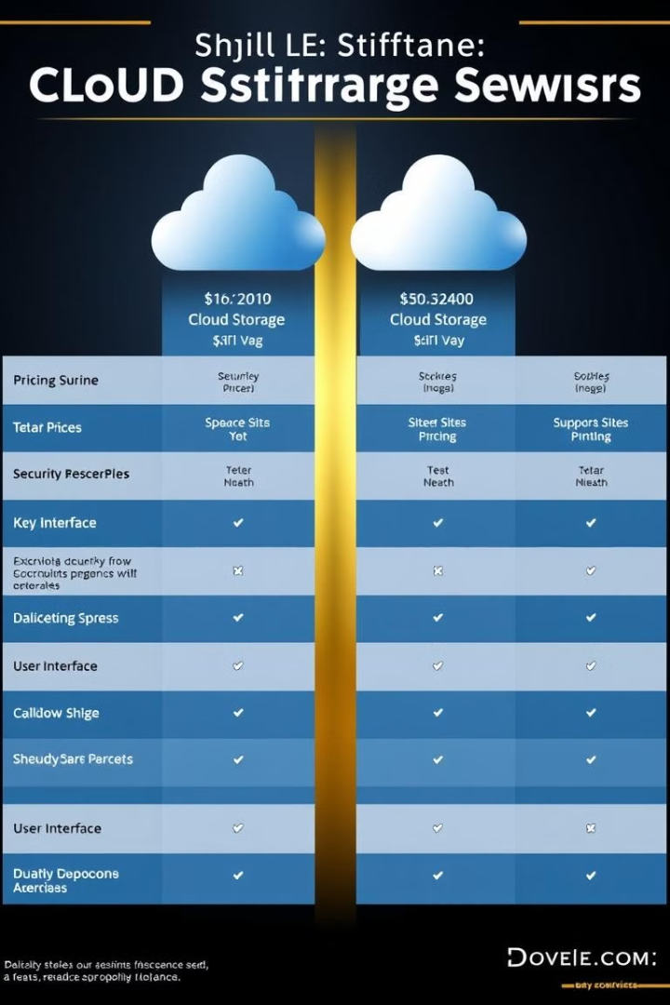
Comparison with AWS S3 & Azure
GCS has competitive pricing, especially in egress costs. It is optimized for high-speed transfers. GCS provides seamless connectivity.
Feature
GCS
AWS S3
Azure Blob
Pricing
Competitive
Standard
Variable
Performance
Optimized
Good
Good
Integration
Seamless
Good
Good

Slide 10
Conclusion
GCS is a powerful, secure, and scalable object storage solution. It delivers reliable solutions. Try GCS with the free tier.
1
Powerful
2
Secure
3
Scalable

